Slide 1
Week 4
SELECTION STRUCTURE
Dr Faisal Bashir

Slide 2
Agenda
Review
Arithmetic Operators, Operator Precedence
Selection Structure
If
If else
Switch

Slide 3
Arithmetic Operators in C/C++
Name Operator Example
Addition + num1 + num2
Subtraction - initial - spent
Multiplication * increment * 6
Division / sum / count
Modulus % m % n

Slide 4
Division By Zero
Division by zero is mathematically undefined.
If you allow division by zero in a program, it will cause a fatal error. Your program will terminate execution and give an error message.
Non-fatal errors do not cause program termination, just produce incorrect results.

Slide 5
Modulus
The expression m % n yields the integer remainder after m is divided by n.
Modulus is an integer operation -- both operands MUST be integers.
Examples : 17 % 5 = 2
6 % 3 = 0
9 % 2 = 1
5 % 8 = 5

Slide 6
Uses for Modulus
Used to determine if an integer value is even or odd
5 % 2 = 1 odd 4 % 2 = 0 even
If you take the modulus by 2 of an integer, a result of 1 means the number is odd and a result of 0 means the number is even.

Slide 7
Arithmetic Operators
Rules of Operator Precedence
Operator(s) Precedence & Associativity
( ) Evaluated first. If nested (embedded), innermost first. If on same level, left to right.
* / % Evaluated second. If there are several, evaluated left to right.
+ - Evaluated third. If there are several, evaluated left to right.
= Evaluated last, right to left.

Slide 8
Using Parentheses
Use parentheses to change the order in which an expression is evaluated.
a + b * c Would multiply b * c first, then add a to the result.
If you really want the sum of a and b to be multiplied by c, use parentheses to force the evaluation to be done in the order you want.
(a + b) * c
Also use parentheses to clarify a complex expression.

Slide 9
Practice With Evaluating Expressions
Given integer variables a, b, c, d, and e, where a = 1, b = 2, c = 3, d = 4,
evaluate the following expressions:
a + b - c + d
a * b / c
1 + a * b % c
a + d % b - c
e = b = d + c / b - a

Slide 10
Selection Structure
Conditions
  Relational Operators
  Logical Operators
if statements
  Two-Alternatives
  One-Alternative
  Nested If Statements
switch Statement

Slide 11
Control Structures
Control structures –control the flow of execution in a program or function.
Three basic control structures:
  Sequential Flow - this is written as a group of statements bracketed by { and }where one statement follows another.
  Selection control structure - this chooses between multiple statements to execute based on some condition.
  Repetition – this structure executes a block of code multiple times.
C
Y
N
Y
C
N

Slide 12
Compound Statements
A Compound statement or a Code Block is written as a group of statements bracketed by { and } and is used to specify sequential flow.
  {
    Statement_1;
    Statement_2;
    Statement_3;
  }
  Example: the main function is surrounded by {}, and its statements are executed sequentially.
  Function body also uses compound statement.

Slide 13
Conditions
A program chooses among alternative statements by testing the values of variables.
  0 means false
  Any non-zero integer means true, Usually, we’ll use 1 as true.
if(a>=b)
printf(“a is larger or equal to b”);
else
printf(“b is larger”);
Condition - an expression that establishes a criterion for either executing or skipping a group of statements
  a>=b is a condition that determines which printf statement we execute.

Slide 14
Relational and Equality Operators
Most conditions that we use to perform comparisons will have one of these forms:
  variable relational-operator variable e.g. a < b
  variable relational-operator constant e.g. a > 3
  variable equality-operator variable e.g. a == b
  variable equality-operator constant e.g. a != 10

Slide 15
Relational and Equality Operators
Operator | Meaning | Type
< | less than | relational
> | greater than | relational
<= | less than or equal to | relational
>= | greater than or equal to | relational
== | equal to | equality
!= | not equal to | equality

Slide 16
Logical Operators
logical expressions - expressions that use conditional statements and logical operators.
  && (and)
    A && B is true if and only if both A and B are true
  || (or)
    A || B is true if either A or B are true
  ! (not)
    !(condition) is true if condition is false, and false if condition is true
    This is called the logical complement or negation
Examples
  (salary < 10000) || (dependants > 5)
  (temperature > 40.0) && (humidity > 90)
  !(temperature > 90.0)

Slide 17
Truth Table && Operator
A | B | A && B
False (zero) | False (zero) | False (zero)
False (zero) | True (non-zero) | False (zero)
True (non-zero) | False (zero) | False (zero)
True (non-zero) | True (non-zero) | True (non-zero)

Slide 18
Truth Table || Operator
A | B | A || B
False (zero) | False (zero) | False (zero)
False (zero) | True (non-zero) | True (non-zero)
True (non-zero) | False (zero) | True (non-zero)
True (non-zero) | True (non-zero) | True (non-zero)

Slide 19
Operator Table ! Operator
A | !A
False (zero) | True (non-zero)
True (non-zero) | False (zero)

Slide 20
Remember!
&& operator yields a true result only when both its operands are true.
|| operator yields a false result only when both its operands are false.

Slide 21
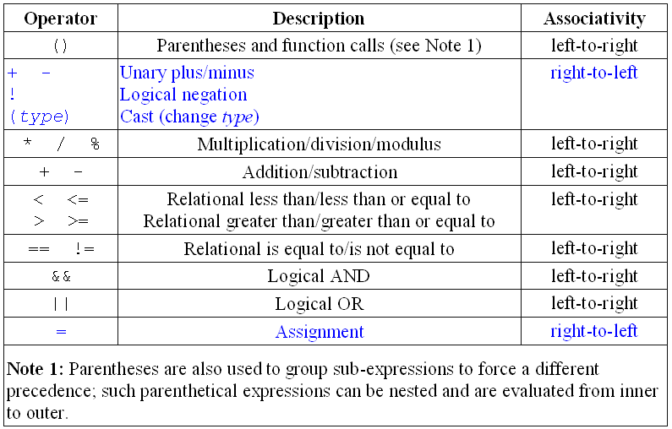
Operator Precedence
Some C/C++ operators in order of precedence (highest to lowest). Their
associativity indicates in what order operators of equal precedence in an
expression are applied.

Slide 22
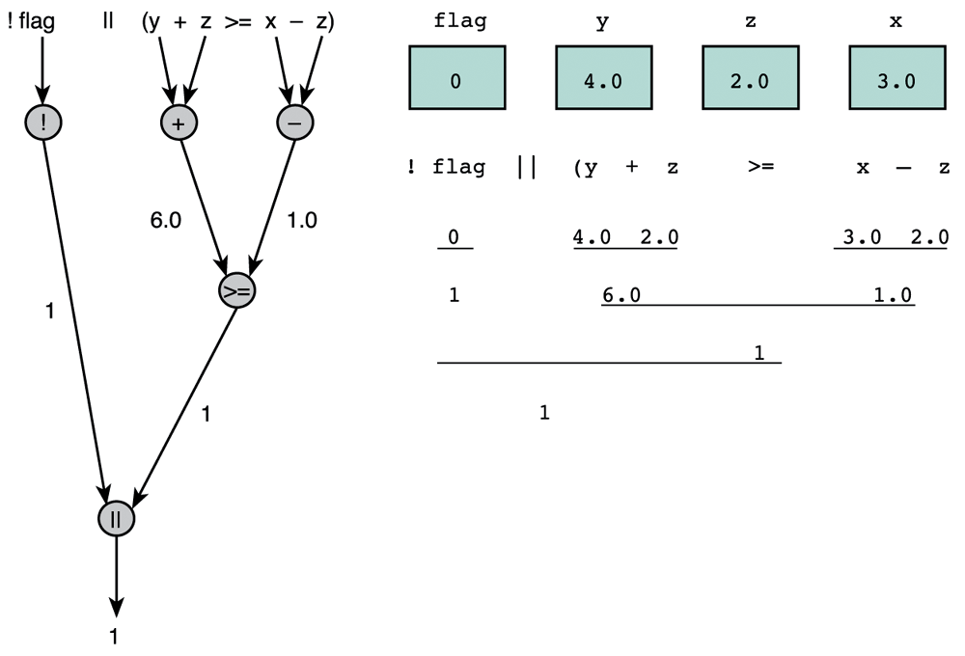
Evaluation Tree and Step-by-Step Evaluation for !flag || (y + z >= x - z)

Slide 23
Writing English Conditions in C/C++
Make sure your C/C++ condition is logically equivalent to an equivalent English statement.
  “x and y are greater than z”
    (x > z) && (y > z) (valid)
    x && y > z (invalid)

Slide 24
Character Comparison
C++ allows character comparison using relational and equality operators.
During comparison alphabetical order is followed. (ASCII: American Standard Code for Information Interchange ).
  ‘9’ >= ‘0’ // True
  ‘a’ < ‘e’ // True
  ‘a’ <= ch && ch <= ‘z’
  /* True if ch is a char type variable that contains a lower case letter.*/

Slide 25
Logical Assignment
You can assign an int type variable a non zero value for true or zero for false.
  Ex: even = (n%2 == 0);
  if(even) { do something }
Some people prefer following for better readability.
#define FALSE 0
#define TRUE !FALSE
// . . .
  even = (n%2 == 0);
  if(even == TRUE) { do something }

Slide 26
Complementing a condition
We can complement a logical expression by preceding it with the symbol !
We can also complement a single condition by changing its operator.
  Example : The complements of (age == 50) are
  !(age == 50) and (age != 50)

Slide 27
if statement : Two alternatives
if (condition)
{compound_statement_1 } // if condition is true
else
{ compound_statement_2 } // if condition is false
Example:
if (crash_test_rating_index <= MAX_SAFE_CTRI) {
cout<<“Car is safe”;
safe = safe + 1;
}
else {
cout<<”Car is unsafe”;
unsafe = unsafe + 1;
}

Slide 28
if statement : Two alternatives…
When the symbol { follows a condition or else, the C complier either executes or skips all statements through the matching }
In the example of the previous slide, if you omit the braces enclosing the compound statements, the if statement would end after the first cout call.
The safe = safe + 1; statement would always be executed.
You MUST use braces if you want to execute a compound statement in an if statement.
To be safe, you may want to always use braces, even if there is only a single statement.

Slide 29
No {}?
if (heart_rate > 72)
printf("Keep up your exercise program!\n");
else
printf("Your heart is in excellent health!\n");
If there is only one statement between the {} braces, you can omit the braces.

Slide 30
One Alternative?
You can also write the if statement with a single alternative that executes only when the condition is true.
if( a <= b )
statement_1;

Slide 31
Nested if Statements
So far we have used if statements to code decisions with one or two alternatives.
A compound statement may contain more if statements.
In this section we use nested if statements (one if statement inside another) to code decisions with multiple alternatives.
if(x > 0)
num_pos = num_pos + 1;
else if(x < 0)
num_neg = num_neg + 1;
else
num_zero = num_zero + 1;

Slide 32
Comparison of Nested if and Sequences of ifs
Beginning programmers sometime prefer to use a sequence of if statements rather than a single nested if statement
if (x > 0)
num_pos = num_pos + 1;
if (x < 0)
num_neg = num_neg + 1;
if (x == 0)
num_zero = num_zero +1;
This is less efficient because all three of the conditions are always tested.
In the nested if statement, only the first condition is tested when x is positive.

Slide 33
Multiple-Alternative Decision Form of Nested if
Nested if statements can become quite complex. If there are more than three alternatives and indentation is not consistent, it may be difficult for you to determine the logical structure of the if statement.
You can code the nested if as the multiple-alternative decision described below:
if ( condition_1 )
statement_1
else if ( condition_2 )
statement_2
.
.
.
else if ( condition_n )
statement_n
else
statement_e

Slide 34
Example
Given a person’s salary, we want to calculate the tax due by adding the base tax to the product of the percentage times the excess salary over the minimum salary for that range.
Salary Range | Base tax | Percentage of Excess
0.00 – 14,999.99 | 0.00 | 15
15,000.00 – 29,999.99 | 2,250.00 | 18
30,000.00 – 49,999.99 | 5,400.00 | 22
50,000.00 – 79,999.99 | 11,000,00 | 27
80,000.00 – 150,000.00 | 21,600.00 | 33

Slide 35
if( salary < 0.0)
tax = -1.0;
else if( salary < 15000.00)
tax = 0.15 * salary;
else if( salary < 30000.00)
tax = (salary – 15000.00)*0.18 + 2250.00;
else if( salary < 50000.00)
tax = (salary – 30000.00)*0.22 + 5400.00;
else if( salary < 80000.00)
tax = (salary – 50000.00)*0.27 + 11000.00;
else if( salary <= 150000.00)
tax = (salary – 80000.00)*0.33 + 21600.00;
else
tax = -1.0;

Slide 36
Order of Conditions in a Multiple-Alternative Decision
When more than one condition in a multiple-alternative decision is true, only the task following the first true condition executes.
Therefore, the order of the conditions can affect the outcome.
The order of conditions can also have an effect on program efficiency.
If we know that salary range 30,000 - 49,999 are much more likely than the others, it would be more efficient to test first for that salary range. For example,
  if ((salary>30000.00) && (salary<=49999.00))

Slide 37
Nested if Statements with More Than One Variable
In most of our examples, we have used nested if statements to test the value of a single variable.
Consequently, we have been able to write each nested if statement as a multiple-alternative decision.
If several variables are involved in the decision, we cannot always use a multiple-alternative decision.
The next example contains a situation in which we can use a nested if statement as a ”filter” to select data that satisfies several different criteria.

Slide 38
Example
The Department of Defense would like a program that identifies single males between the ages of 18 and 26, inclusive.
One way to do this is to use a nested if statement whose conditions test the next criterion only if all previous criteria tested were satisfied.
Another way would be to combine all of the tests into a single logical expression
In the next nested if statement, the call to printf executes only when all conditions are true.

Slide 39
Example
/* Print a message if all criteria are met.*/
if ( marital_status == ’S’ )
if ( gender == ’M’ )
if ( age >= 18 && age <= 26 )
printf("All criteria are met.\n");
or we could use an equivalent statement that uses a single if with a compound condition:
/* Print a message if all criteria are met.*/
if ((maritial_status == ’S’) && (gender == ’M’) &&
(age >= 18 && age <= 26))
printf("All criteria are met.\n");

Slide 40
Common if statement errors
if ch == ’C’
printf("Character\n");
This error is that there are no ( ) around the condition, and this is a syntax error.
if (ch == ’C’);
printf("Character\n");
This error is that there is a semicolon after the condition. C will interpret this as there is nothing to do if the condition is true.

Slide 41
If Statement Style
All if statement examples in this lecture have the true statements and false statements indented. Indentation helps the reader but conveys no meaning to the compiler.
The word else is typed without indentation on a separate line.
This formatting of the if statement makes its meaning more apparent and is used solely to improve program readability.

Slide 42
Switch statements
The switch statement is a better way of writing a program when a series of if-else if occurs.
The switch statement selects one of several alternatives.
The switch statement is especially useful when the selection is based on the value of a single variable or of a simple expression
  This is called the controlling expression
In C, the value of this expression may be of type int or char, but not of type double.

Slide 43
Example of a switch Statement with Type char Case Labels
/* Determines the class of Ship given its class ID */
#include <stdio.h>
int main(void) {
char classID;
printf("Enter class id [a, b, c or d]: ");
scanf("%c", &classID);
switch (classID) {
case 'B':
case 'b':
printf("Battleship\n");
break;
case 'C':
case 'c':
printf("Cruiser\n");
break;
case 'D':
case 'd':
printf("Destroyer\n");
break;
case 'F':
case 'f':
printf("Frigate\n");
break;
default:
printf("Unknown ship class %c\n", classID);
}
return 0;
}

Slide 44
Explanation of Example
This takes the value of the variable class and compares it to each of the cases in a top down approach.
It stops after it finds the first case that is equal to the value of the variable class.
It then starts to execute each line of the code following the matching case till it finds a break statement or the end of the switch statement.
If no case is equal to the value of class, then the default case is executed.
  default case is optional. So if no other case is equal to the value of the controlling expression and there is a default case, then default case is executed. If there is no default case, then the entire switch body is skipped.

Slide 45
Remember !!!
The statements following a case label may be one or more C statements, so you do not need to make multiple statements into a single compound statement using braces.
You cannot use a string such as ”Cruiser” or ”Frigate” as a case label.
  It is important to remember that type int and char values may be used as case labels, type double values cannot be used.
Another very common error is the omission of the break statement at the end of one alternative.
  In such a situation, execution ”falls through” into the next alternative.
Forgetting the closing brace of the switch statement body is also easy to do.
In the book it says that forgetting the last closing brace will make all following statements occur in the default case, but actually the code will not compile on most compilers.

Slide 46
Nested if versus switch
Advantages of if:
  It is more general than a switch
    It can be a range of values such as x < 100
  A switch can not compare doubles
Advantages of switch:
  A switch is more readable
Use the switch whenever there are ten or fewer case labels

Slide 47
Common Programming Errors
Consider the statement:
if (0 <= x <= 4)
This is always true!
  First it does 0 <= x, which is true or false so it evaluates to 1 for true and 0 for false
  Then it takes that value, 0 or 1, and does 1 <= 4 or 0 <= 4
  Both are always true
In order to check a range use (0 <= x && x <= 4).
Consider the statement:
if (x = 10)
This is always true!
  The = symbol assigns x the value of 10, so the conditional statement evaluates to 10
  Since 10 is nonzero this is true.
  You must use == for comparison

Slide 48
More Common Errors
Don’t forget to parenthesize the condition.
Don’t forget the { and } if they are needed
C matches each else with the closest unmatched if, so be careful so that you get the correct pairings of if and else statements.
In switch statements, make sure the controlling expression and case labels are of the same permitted type.
Remember to include the default case for switch statements.
Don’t forget your { and } for the switch statement.
Don’t forget your break statements!!!

Slide 49
PRACTICE EXERCISE Given the following declarations: int j = 0, m = 1, n = -1; float x = 2.5, y = 0;
Expression | Equivalent Expression | Result
j && m | (j) && (m) | 0
j < m && n < m | (j < m) && (n < m) | 1
m + n || ! j | (m + n) || (!j) | 1
x * 5 && 5 || m / n | ((x * 5) && 5) || (m / n) | 1
!x || !n || m+n | ((!x) || (!n)) || (m+n) | 0
x * y < j + m || n | ((x * y) < (j + m)) || n | 1
(x > y) + !j || n++ | ((x > y) + (!j)) || (n++) | 1
(j || m) + (x || ++n) | (j || m) + (x || (++n)) | 2

